Slide 1
Magnetic Control of Liquid Mirrors in Microgravity
August 25
Álvaro Romero-Calvo, Ph.D.
DARPA Zenith Lecture 1

Slide 2
Liquid Mirror Telescopes (LMT)
A historical overview

Slide 3
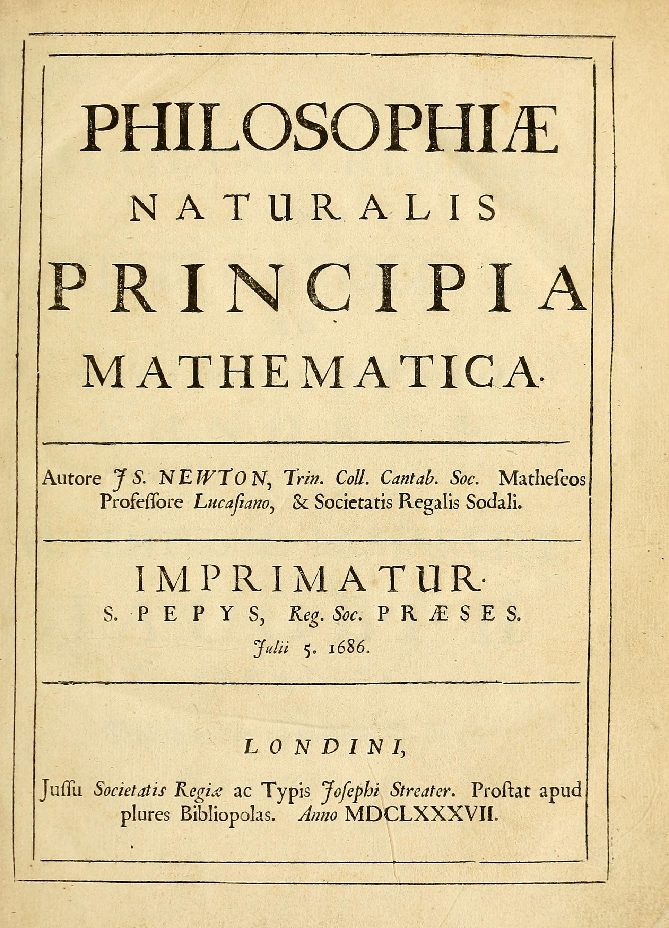
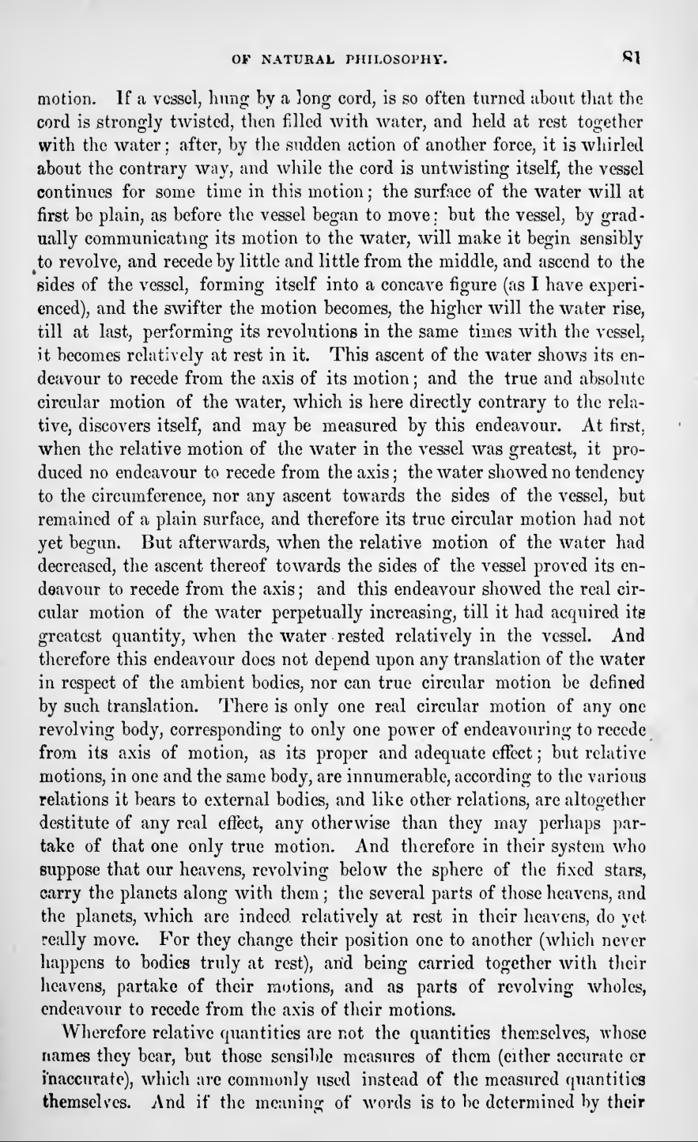
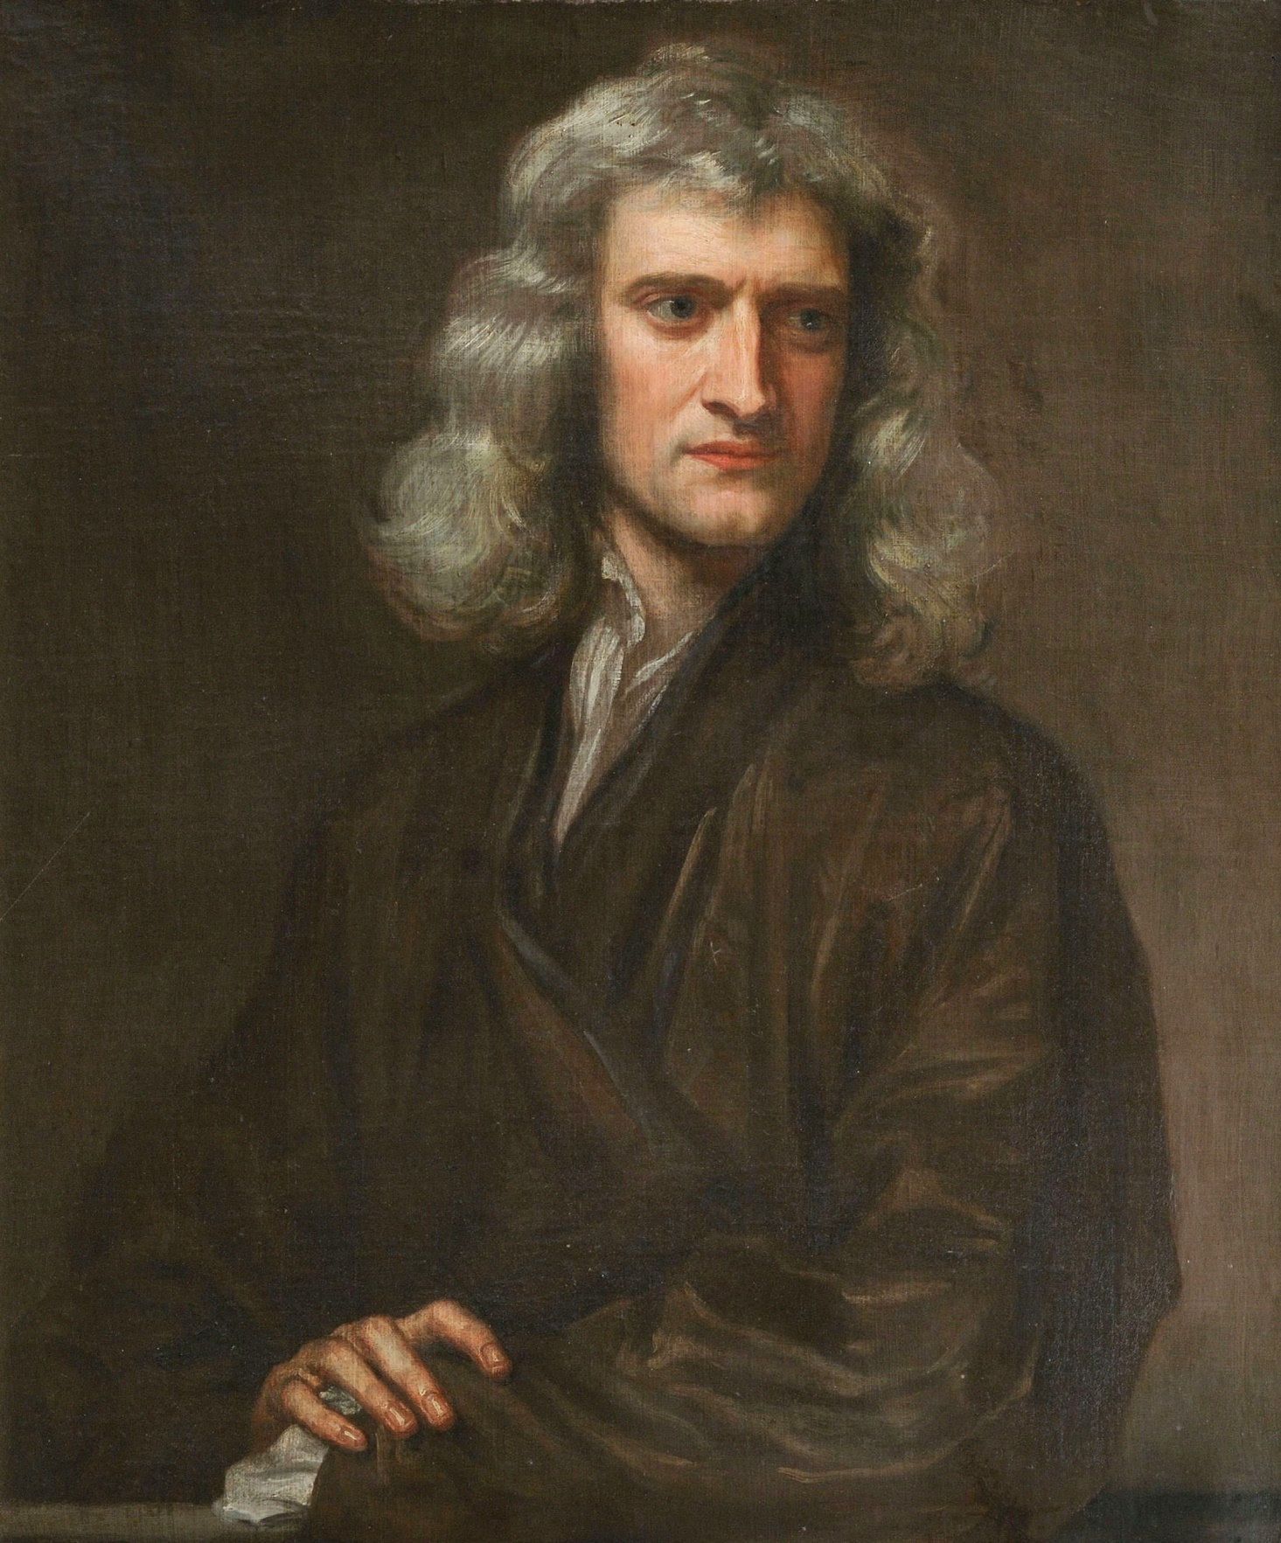
Newton’s Philosophiae,
Book 1: Definitions – Scholium,
1687

Slide 4
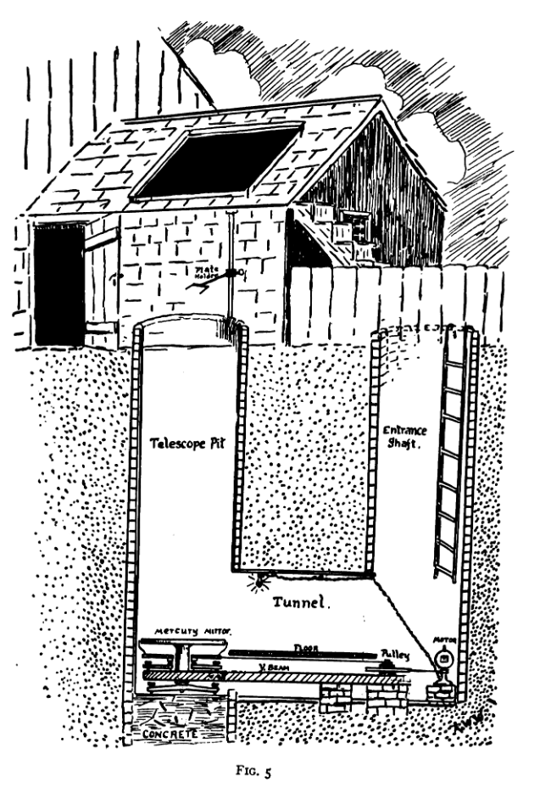
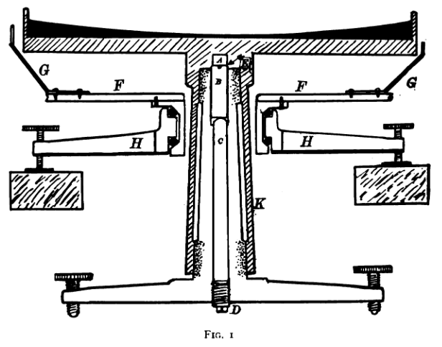
First attempt, 1909
R.W. Wood, “The Mercury Paraboloid as a Reflecting Telescope”, Astrophysical Journal, Vol. 29, p. 164, 1909

Slide 5
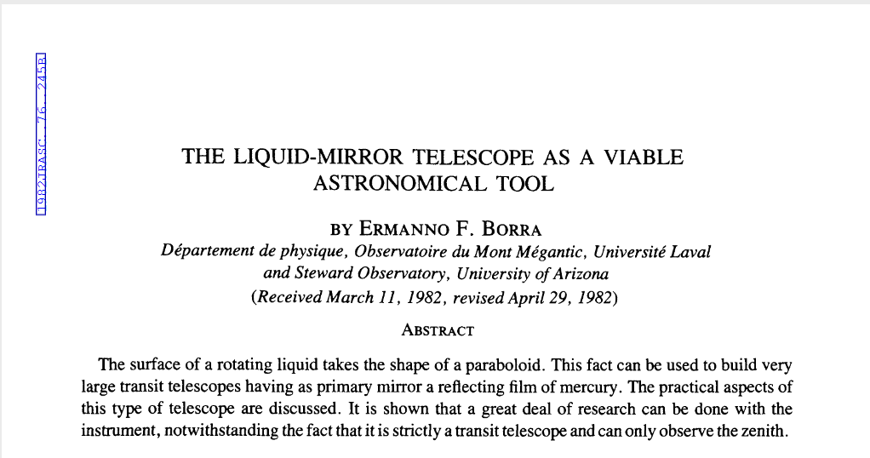
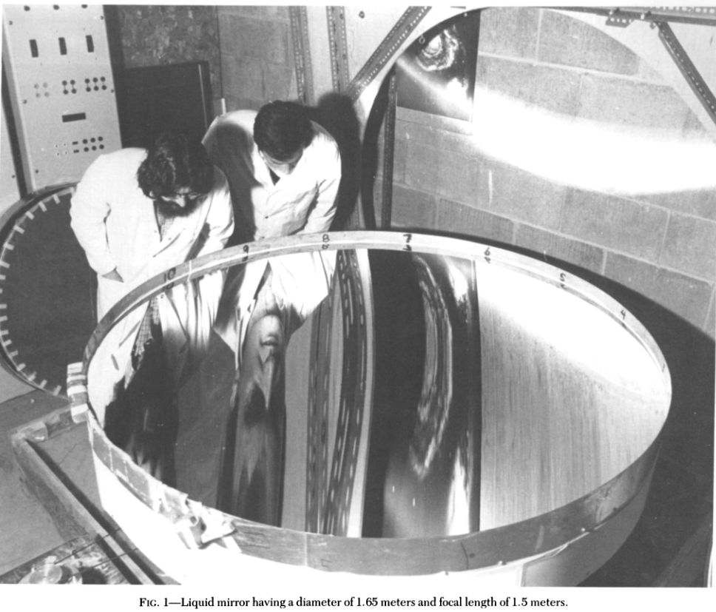
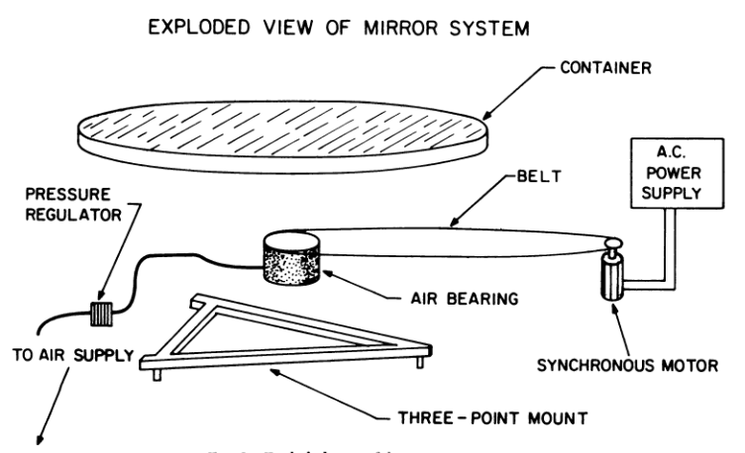
Modern LMTs, 1982-1989
Ermann F. Borra, The Liquid Mirror Telescope as a Viable Astronomical Tool, J. Roy, Astron. Soc. Can, Vol. 76, No. 4, 1982

Slide 6
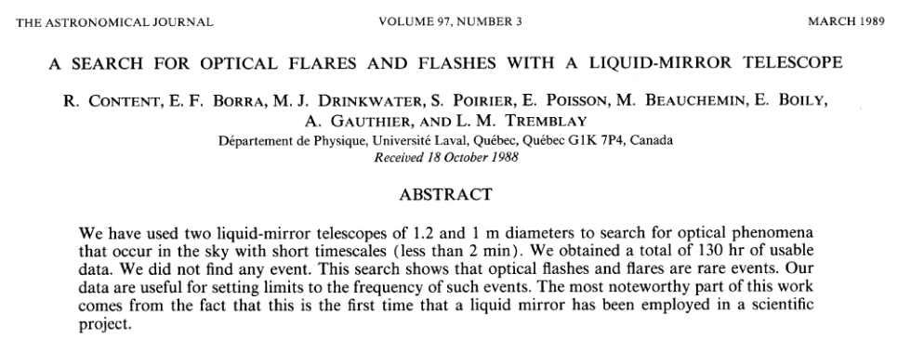
First astronomical use of an LMT, 1989

Slide 7
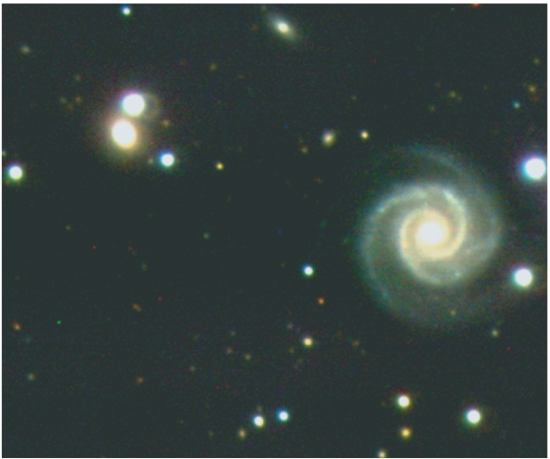
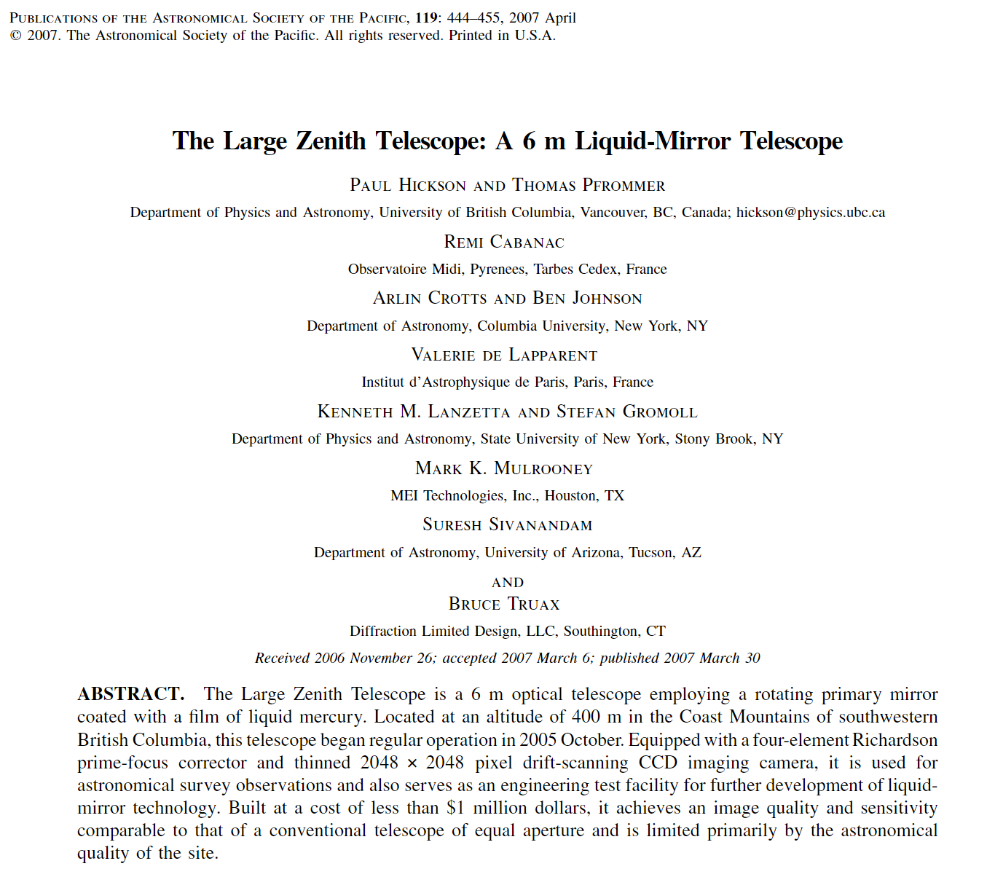
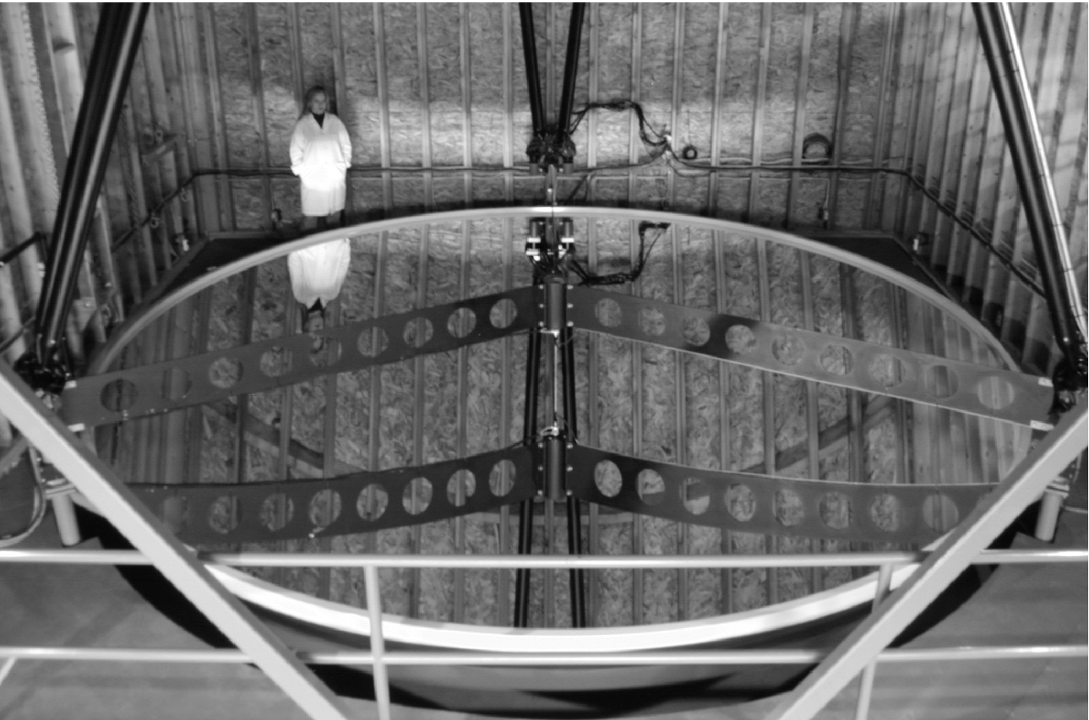
The Large Zenith Telescope

Slide 8
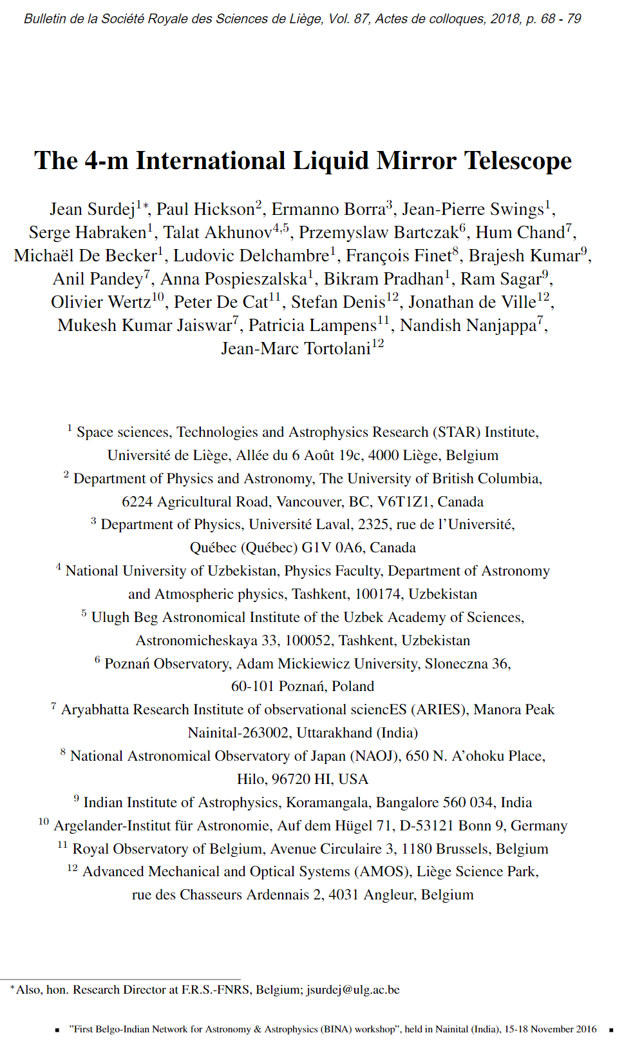
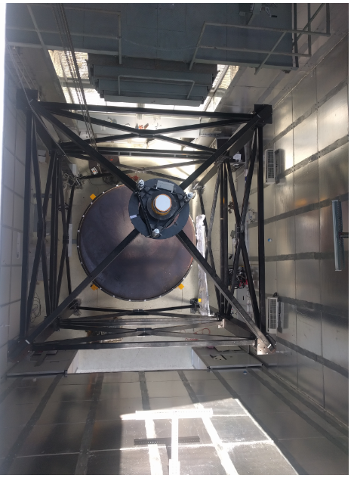
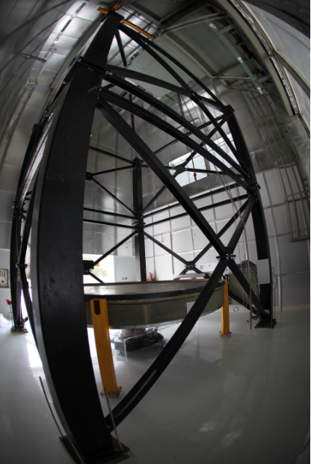
The 4m International LMT

Slide 9
Analytical approach to low-gravity liquid interfaces
“The only rules that really matter are these:
What a man can do and what a man can't do”
Jack Sparrow

Slide 10
State of the art for microgravity mirrors
There is one question that may have been overlooked:
Previously proposed solutions: high-viscosity liquid cycling, thermal fields, Lorentz forces, spherical mirrors, active correction, ferrofluids…
Unfortunately, previous works on ferrofluid-based liquid mirrors…
Introduce non-scalable magnetic configurations in terms of geometry, power, or propellant management (e.g. continuous thrust)
Employ questionable fluid and electromagnetic models: no fluid-magnetic coupling, completely ignore surface tension, do not consider important disturbance factors, do not set a clear target/application, etc.
Large-radius ground telescopes are limited by self-induced winds
Is it feasible to produce the surface profile we need in microgravity?

Slide 11
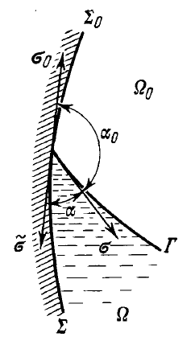
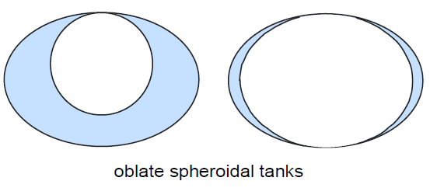
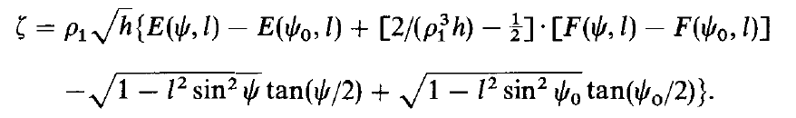
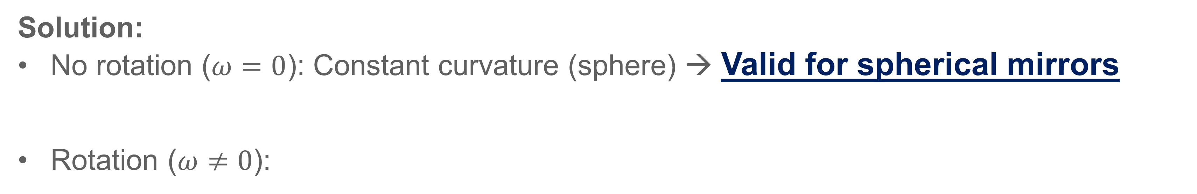
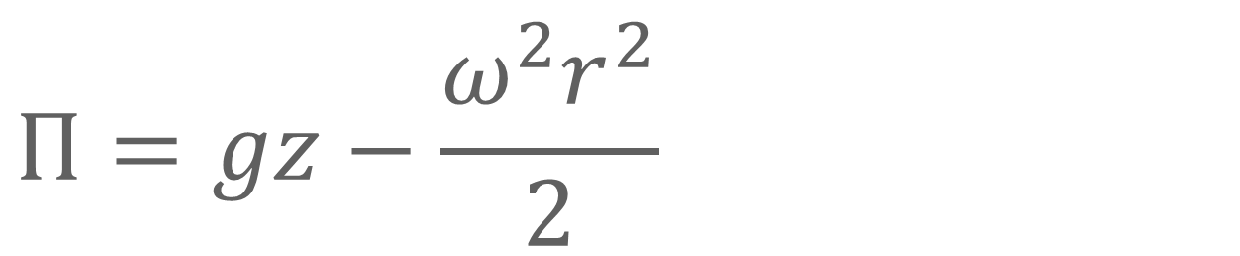
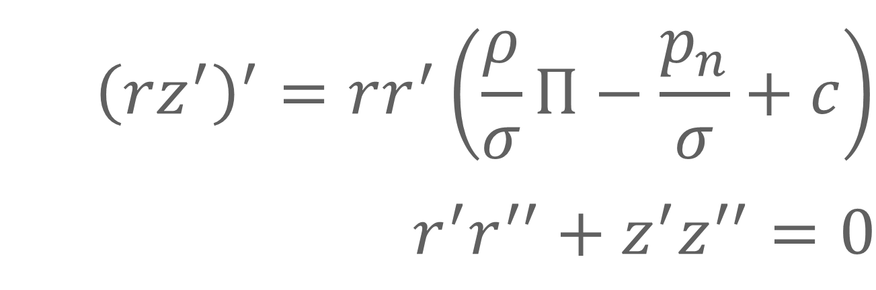
The axisymmetric meniscus
Equilibrium liquid-gas interface (meniscus)
Mass-force potential
$${\left(rz^{′}\right)}^{′}=rr^{′}\left(\frac{ρ}{σ}Π−\frac{p_{n}}{σ}+c\right)$$
$$r^{′}r^{′′}+z^{′}z^{′′}=0$$
$$Π=gz−\frac{ω^{2}r^{2}}{2}$$
Microgravity
Solution:
No rotation ($ω=0$): Constant curvature (sphere) → Valid for spherical mirrors
Rotation ($ω≠0$):
Axisymmetric liquid interfaces naturally adopt spherical profiles in microgravity
We need additional body forces to generate paraboloid surfaces

Slide 12
Using ferrofluids
An alternative that may solve the problem in 3 steps

Slide 13
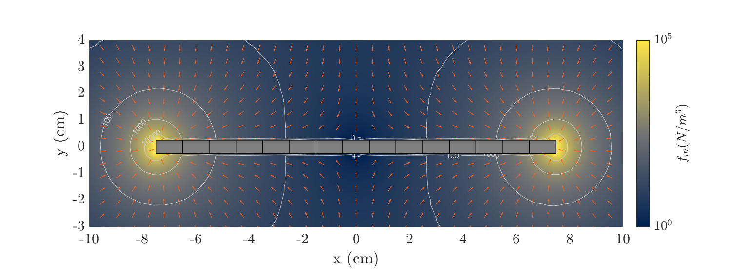
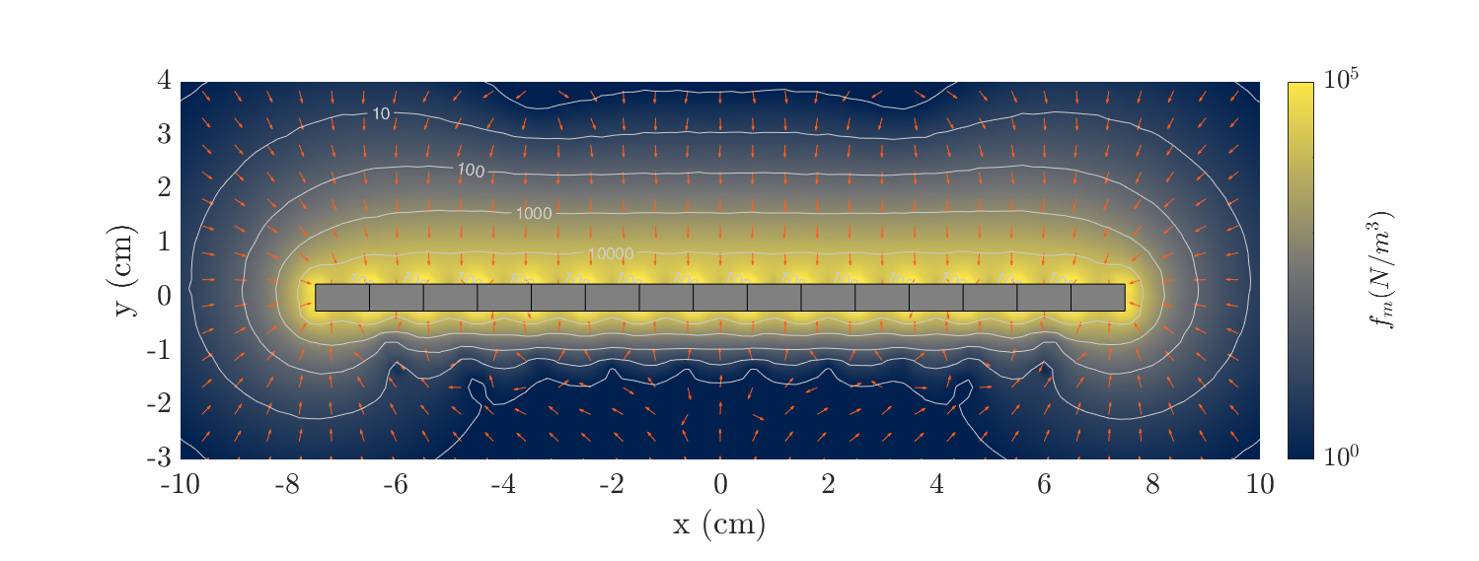

Step 1: Generating a suitable force field
“Standard” magnet
Uniform magnetization
Analogous to what has already been proposed
Inhomogeneous field
Force “concentrated” in extremes
Halbach Array
Oriented magnetization vectors
Quasi-uniform force on one axis
Can be simplified to alternate polarity (simpler config., lower performance)
Scalable
Readily available (N52 magnets)
Tunable, with some work
$$χ=0.001$$

Slide 14
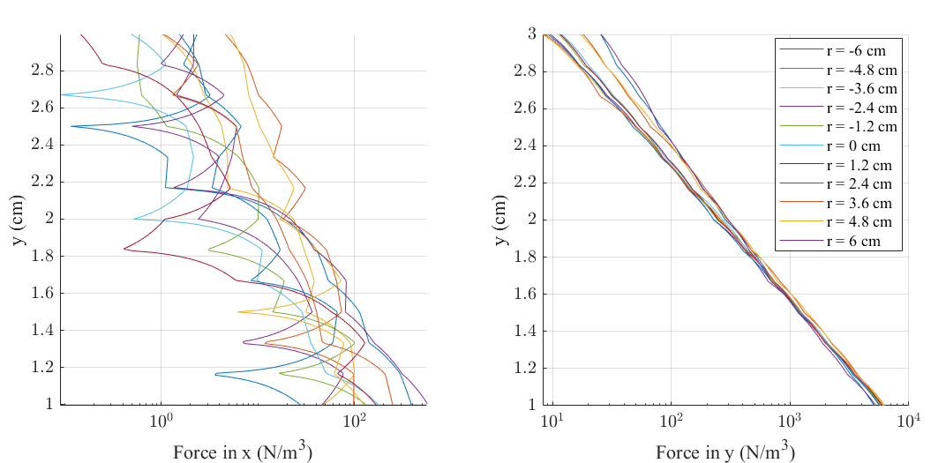
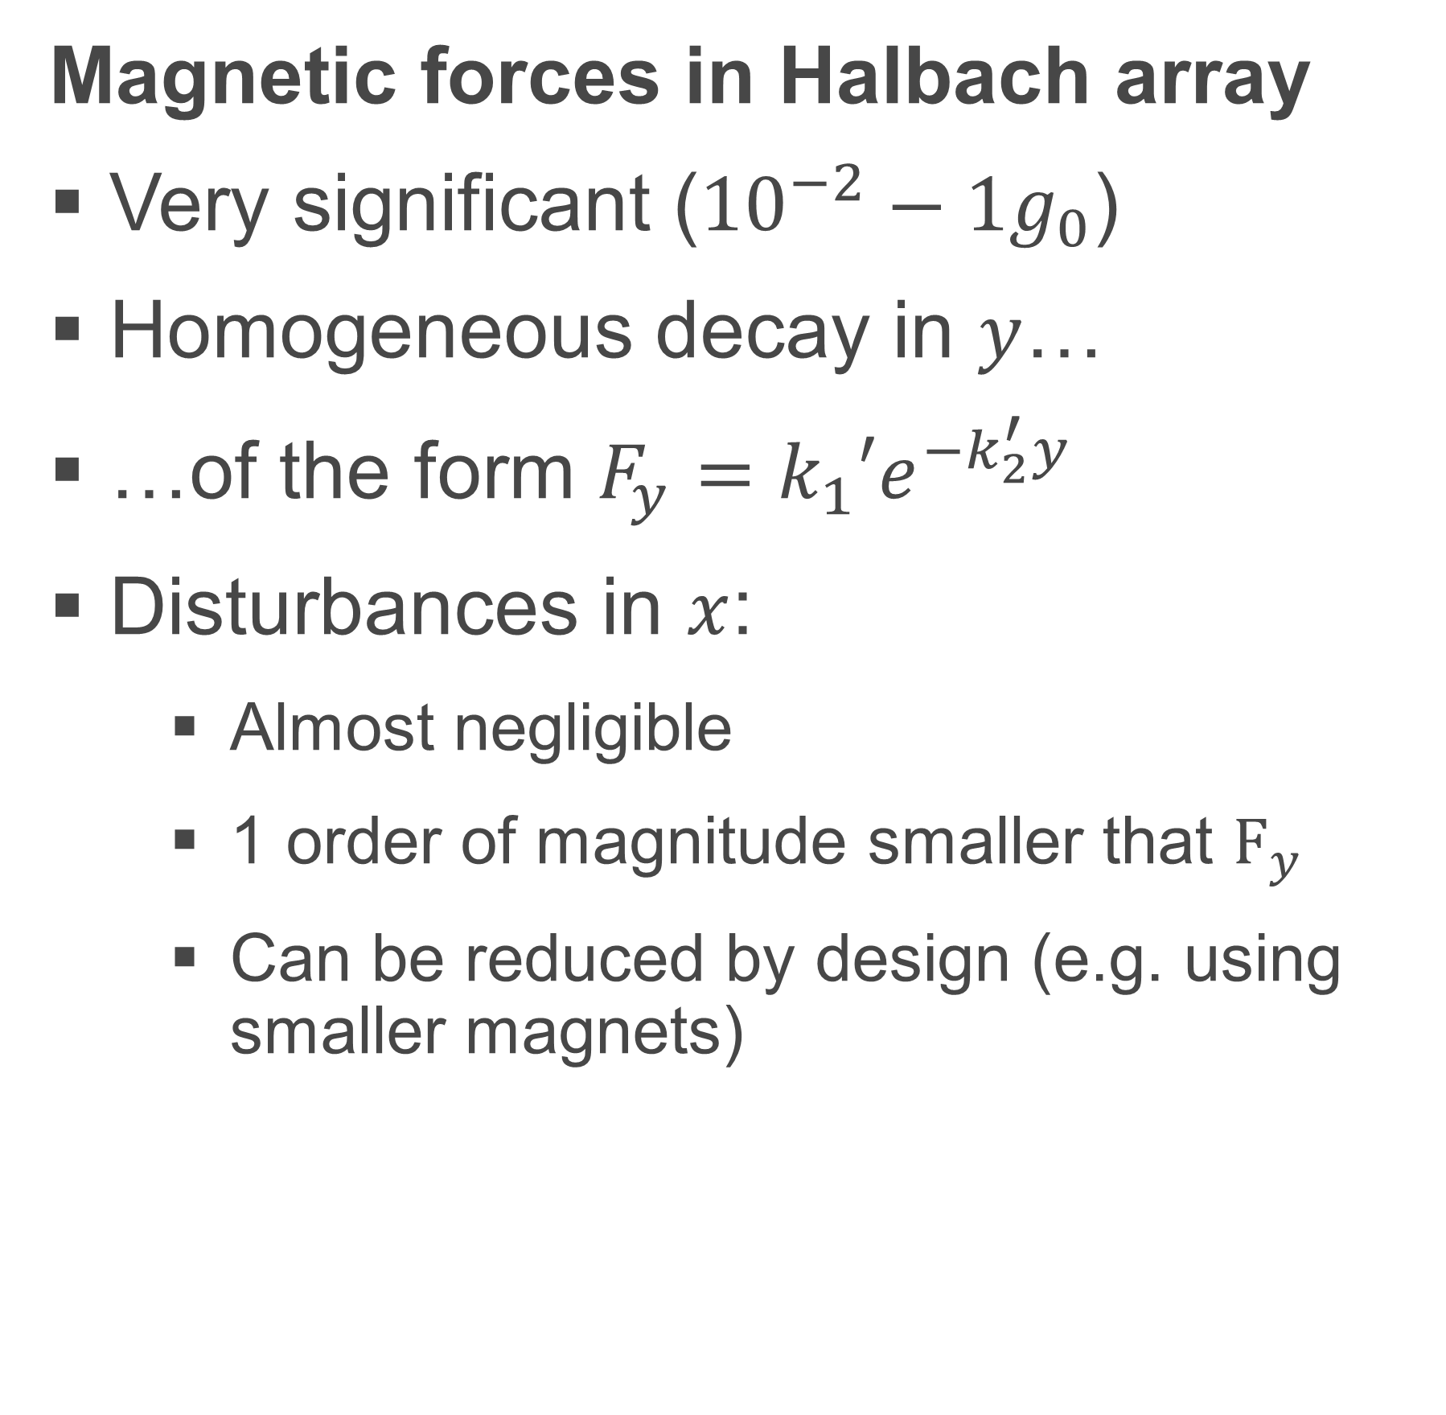

Step 1: Generating a suitable force field
Magnetic forces in Halbach array
Very significant (${10}^{−2}−1g_{0}$)
Homogeneous decay in $y$…
…of the form $F_{y}={k_{1}′e}^{−k_{2}^{′}y}$
Disturbances in $x$:
Almost negligible
1 order of magnitude smaller that $F_{y}$
Can be reduced by design (e.g. using smaller magnets)
$$χ=0.001$$
Halbach arrays provide a means to homogenize the magnetic force potential distribution on ferrofluids

Slide 15
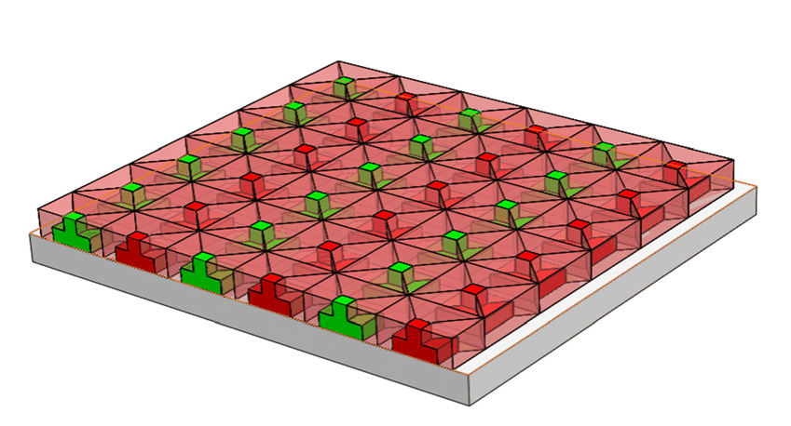
Step 1: Generating a suitable force field
… and all of this applies to 2D problems as well
Zhang et al., “Analysis and comparison of two two-dimensional Halbach permanent magnet arrays for magnetically levitated planar motor”, Journal of Applied Physics 115, 17E704, 2014

Slide 16
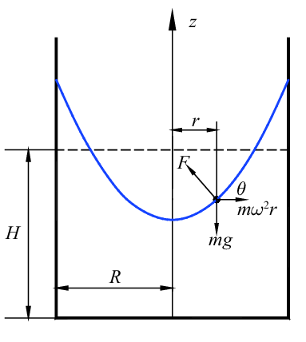
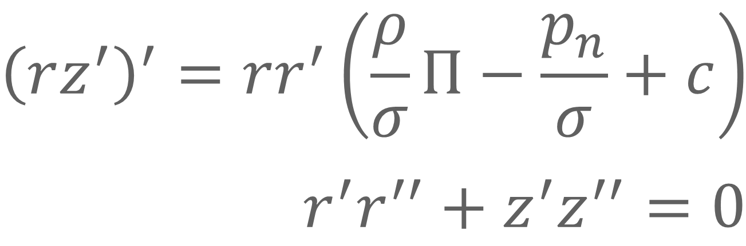
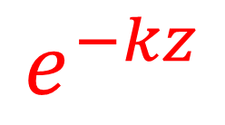
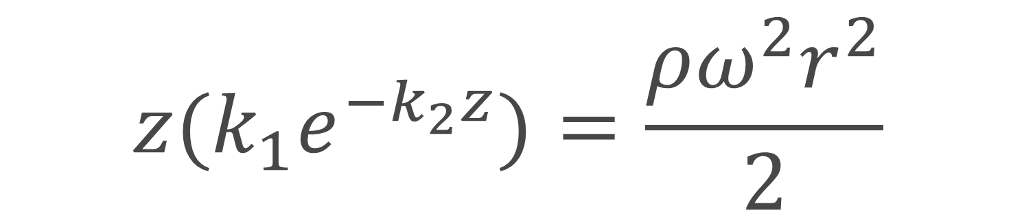
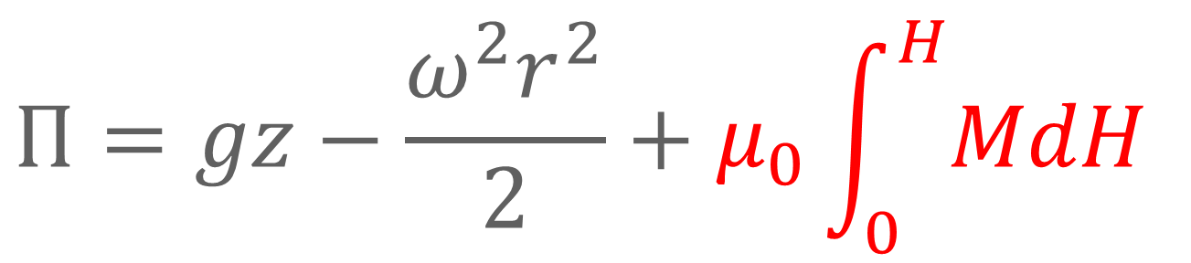
Step 2: Exploiting the force field
Strategy 1: Artificially-induced gravity using Halbach arrays + rotation
Non-capillary
Capillary
Equilibrium liquid-gas interface (meniscus)
$${\left(rz^{′}\right)}^{′}=rr^{′}\left(\frac{ρ}{σ}Π−\frac{p_{n}}{σ}+c\right)$$
$$r^{′}r^{′′}+z^{′}z^{′′}=0$$
Mass-force potential (including magnetic terms)
$$Π=gz−\frac{ω^{2}r^{2}}{2}+μ_{0}\int_{0}^{H}{MdH}$$
$$e^{−kz}$$
$$z{(k_{1}e}^{−k_{2}z})=\frac{ρω^{2}r^{2}}{2}$$
Only feasible for small deformations
(i.e. large focal lengths!)

Slide 17
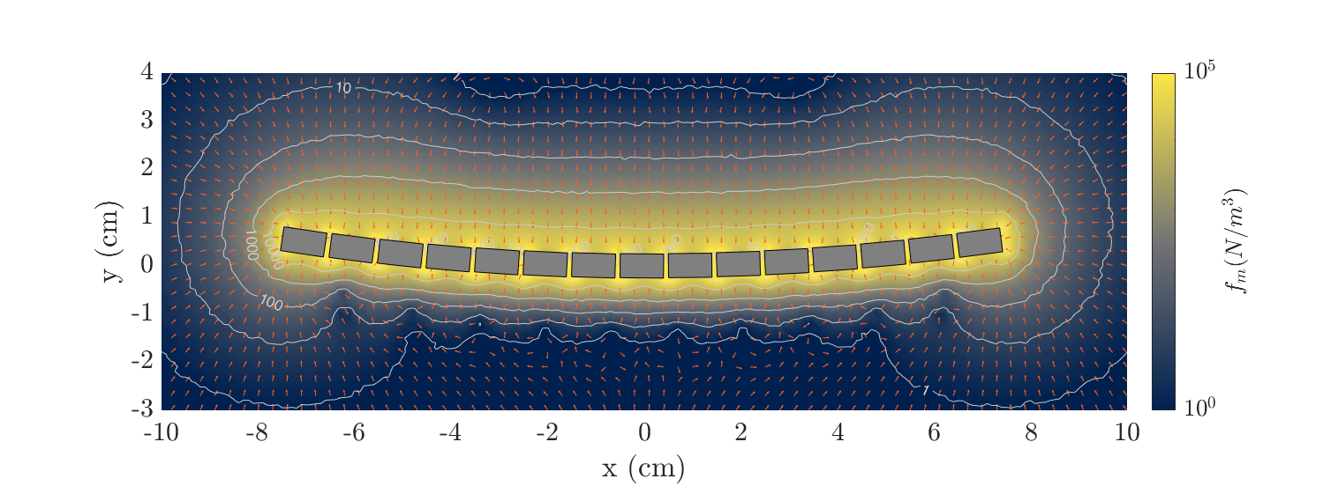
Step 2: Exploiting the force field
Strategy 2: Equipotential tuned surface using Halbach arrays. No rotation
Ferrofluid layer
Debris
Shield
Also works for
1 g tilting!!

Slide 18
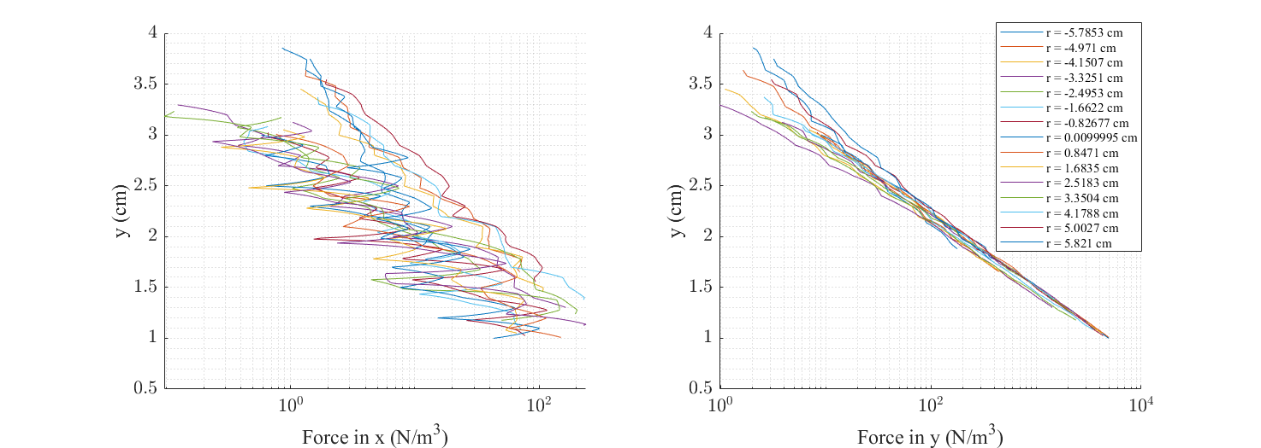
Force field of tilted Halbach magnet array

Slide 19

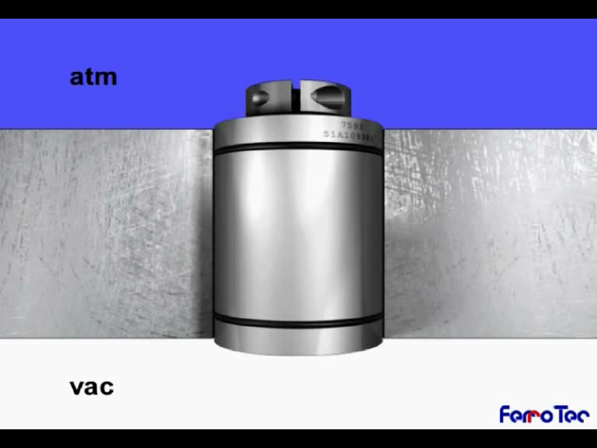
Step 3: Finding a suitable ferrofluid
Task 1:
Characterize optical properties of existing Vacuum Seal Grade (VSG) ferrofluids
Test outgassing in application context
Define operational T range (usually < 70º-100º C)
Task 2:
Explore optically enhanced ferrofluids (e.g. metal-based, metal liquid-like films, etc.)
Characterize optical properties

Slide 20
Questions?
DARPA Zenith Lecture 1

